Slide 1

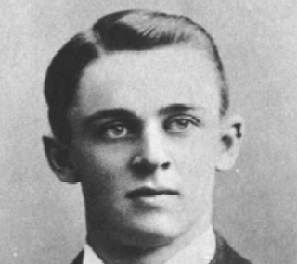
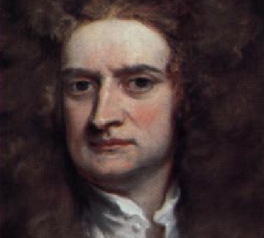
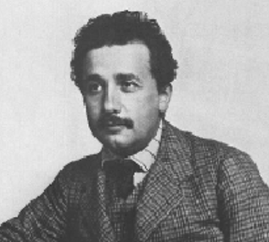
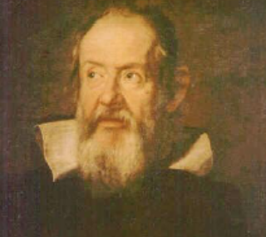
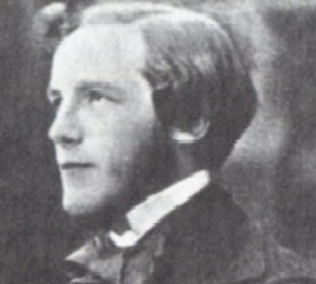
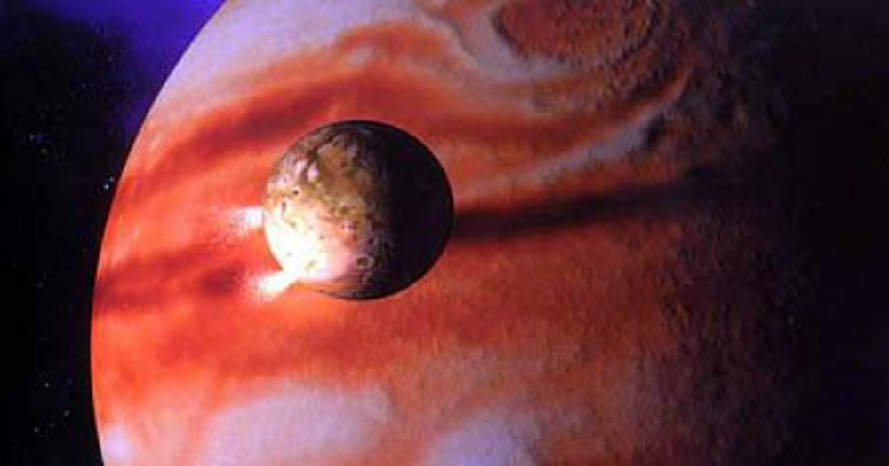

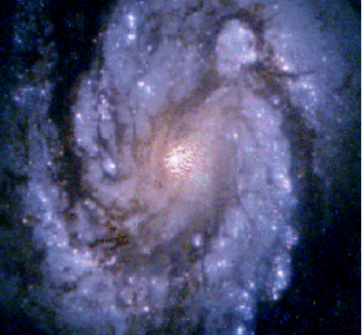
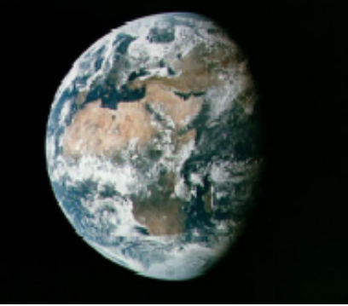
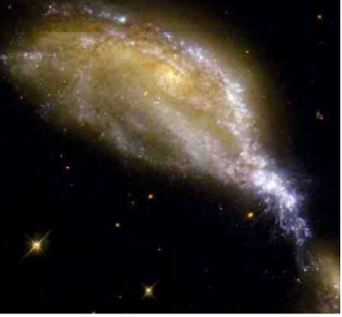
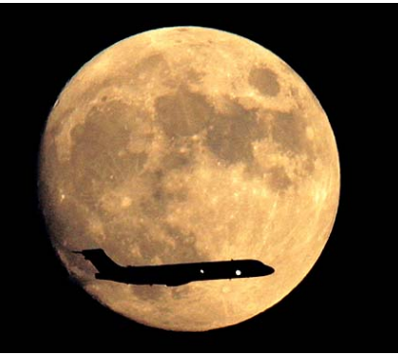
Welcome to
The Physical World !
the world of Physics !

Slide 2
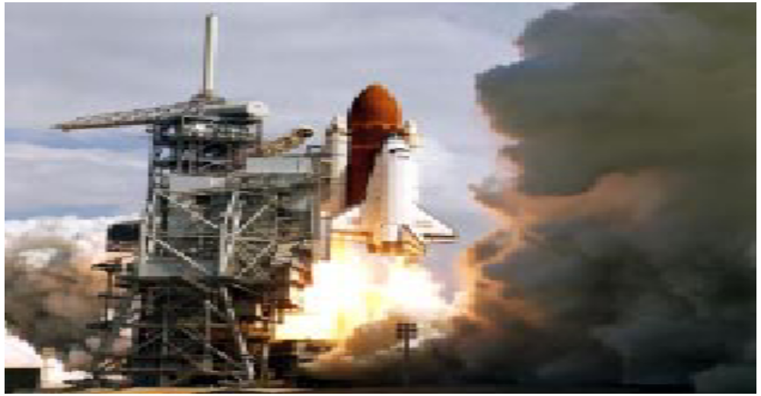

Chapter 0 Introduction

Slide 3
§1.Overview
1.Structure of Physics

Origin of Physics: for fun?
From everyday life;
For Good life.
Experiments Base of Physics
Phenomenology
Philosophy
Religion
Theory
Provide Game Laws
Mathematics
Language of Physics

Slide 4
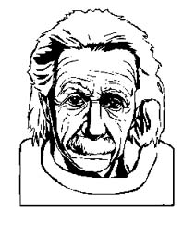
Inner & outer logic
Outer logic
Inner logic
(maths)
Principles
Nature Experiment
Intuition
educated
guesses

Slide 5
←Physics is Fundamental
Chemistry
Described by
Physical term
Biology
:
Physics exist
everywhere.
IT, Economics

Slide 6
2.Courses for Physics Major
Mechanics
Electromagnetic
Fundamental
Physics
Thermal Physics classified by feel
Optics
Modern Physics(Atomic Physics)
Classical Physics
Advanced
Courses
Electrodynamics
Optics light Maxwell
Thermodynamics and Statistical Physics
Quantum Mechanics
Base of Modern
Physics
Special Relativity

Slide 7
Research Field:
Solid state Physics
(Many-body system)
Condensed Matter Physics
Experiments
Theory
Mesoscopic Physics (Quantum Computer) Nano-tube
Interaction Laser and solid (crystal)
(Electrodynamics and Quantum Mechanics)
Particle and Field (Quantum Field Theory)
Nuclear Physics
General Relativity
Astrophysics (cosmics)
Big Bang
Black hole
Statistical Physics
Supernova

Slide 8
3.Why we learn Physics?
Philosophy
Physics is science
How to think
Training
Apply physics to everywhere
Doing research in Physics
4.How to learn
Mechanics Basic training
Newton’s law + Mathematics
Learn how to establish model
(Finding Problem , reasoning, solving)

Slide 9
5. Homework, Exams & Grade
Homework ( paper, e-version) & quiz 15%
Midterm 40%
Final 45%

Slide 10

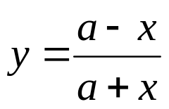
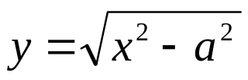

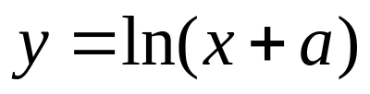
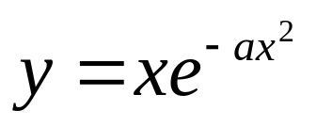
Quiz
Some question.
 Why do you choose physics?
 What is your favorite in physics?
● What is your curious(what do you want?)?
Find out the derivative of the following Functions


●
❍
■
□

Slide 11
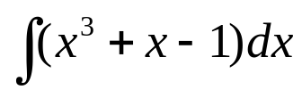
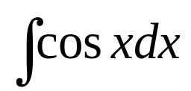
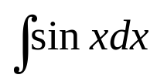
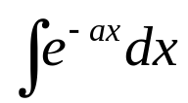
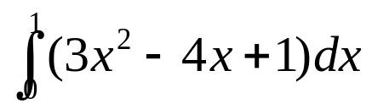
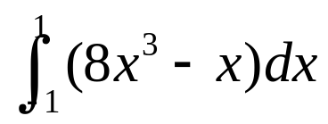
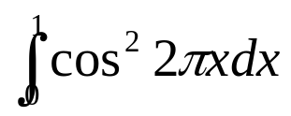
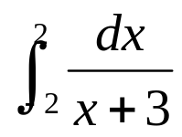
Find out infinite integration


●
❍
Find out integration


●
❍

Slide 12
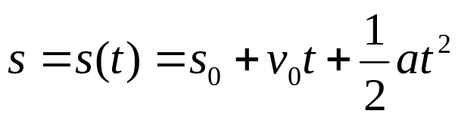
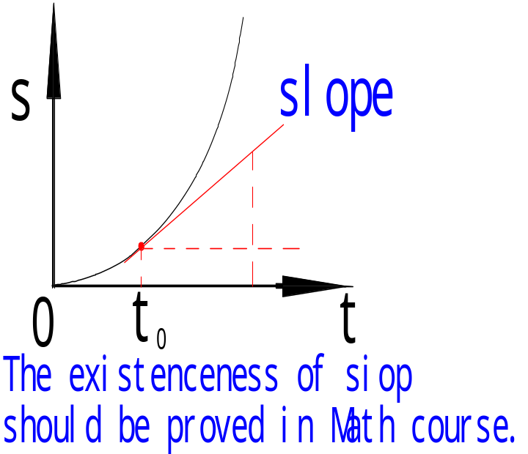
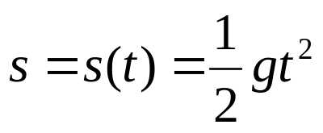
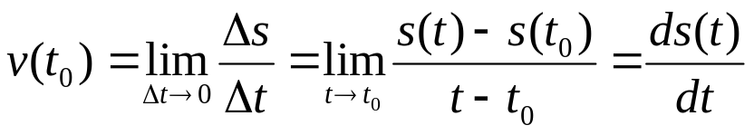
§2.Mathematical Preliminaries
Any Physical law can be represented by the function of variables.
For example :
Free fall: parabola
Figure we know velocity(v=gt)
Problem:How to get velocity from s(t)
In geometry it is slope of the function.
Definition:
   Limit;
   Derivative;
  ● ds(t) differential,infinitesmal
1.The Derivative of Function Differential Calculus

Slide 13
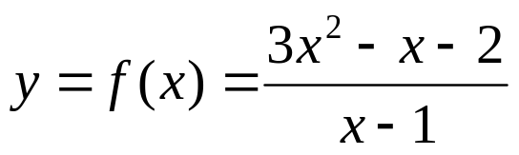
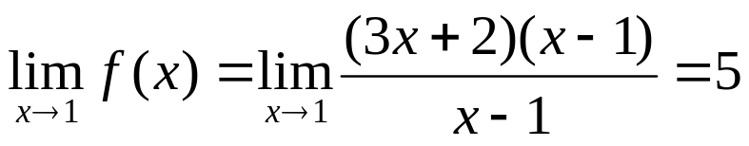

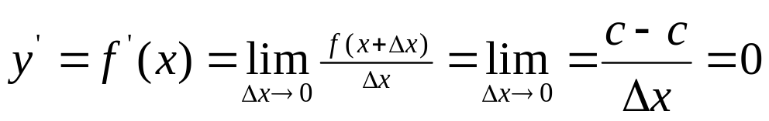

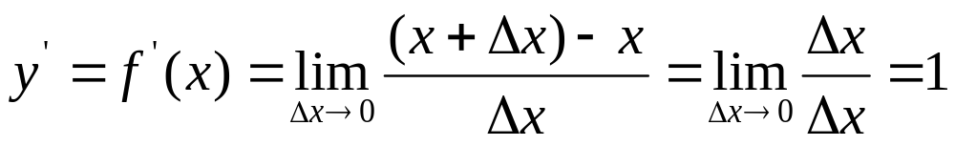
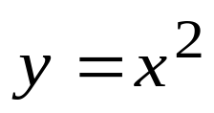
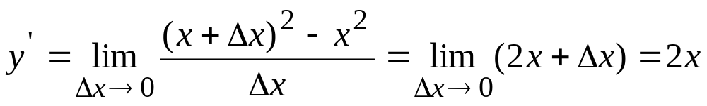
Limit:
Formulas for simple functions


●

Slide 14
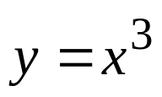
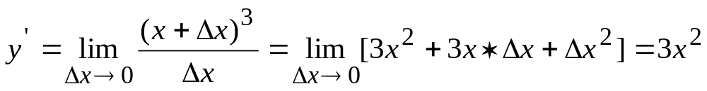
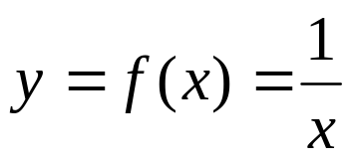
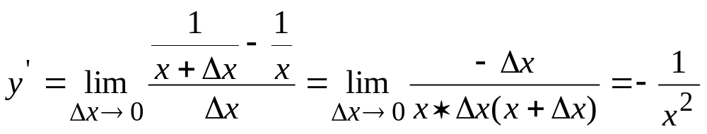
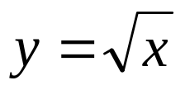
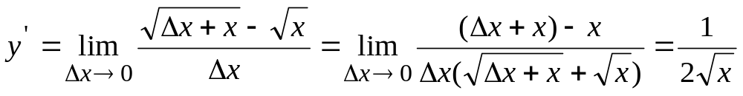
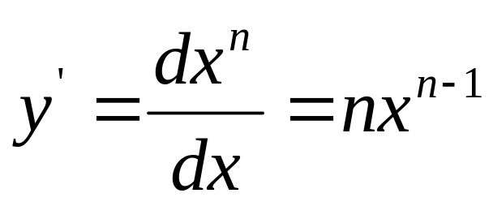
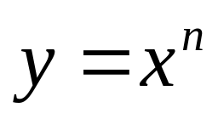
❍
■
□
Conclusion:

Slide 15
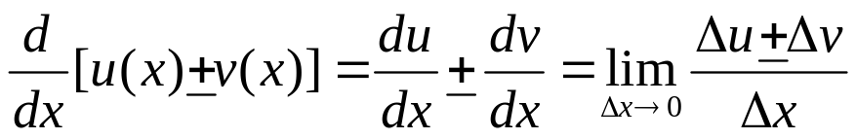
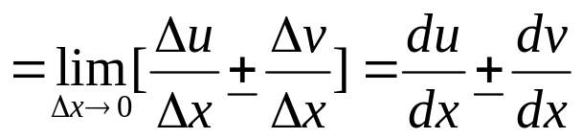
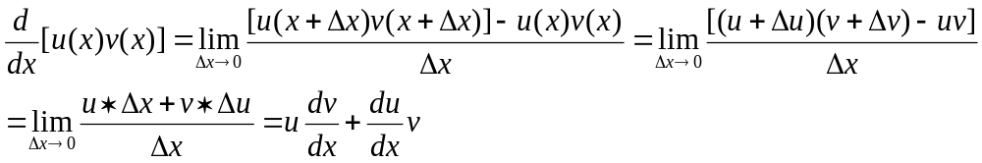
Theorem 1.
Theorem 2.
Notes:
Theorem 2----exchangable
Theorem 3------prove it as homework.

Slide 16
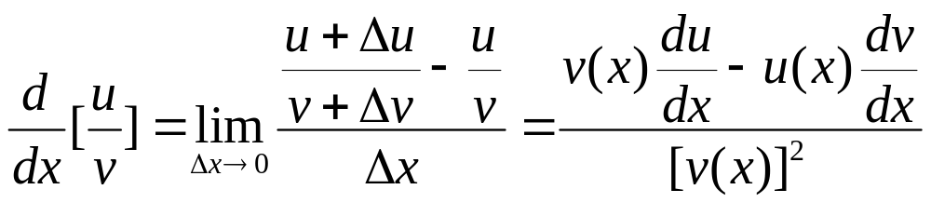
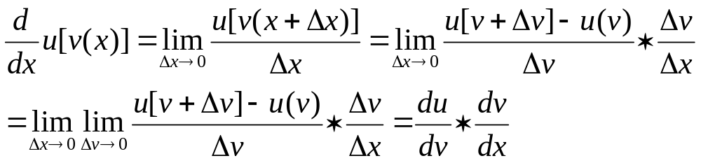
Theorem 3.
Theorem 4.

Slide 17
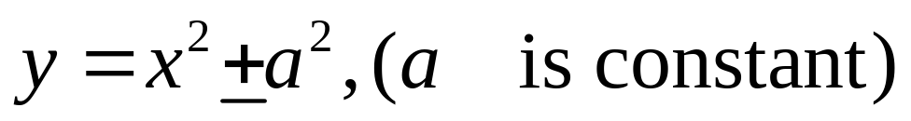
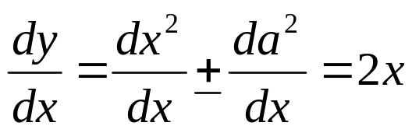
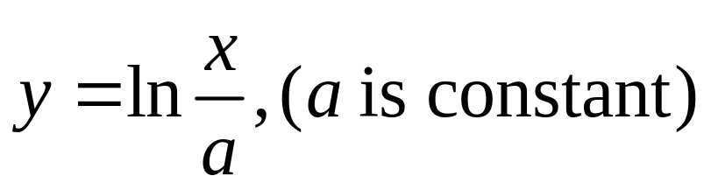



Examples:


●

Slide 18





❍
■
□

Slide 19






❐
❑

Slide 20





❒
Homework:
Prove theorem 3;
Table A-2. (learn by heart)
A-2, A-3

Slide 21











2.Integral calculus
Example:
 Distance ?
When time interval is small enough,
is uniform and dt

Slide 22




Work ?(F=Const)
When F is not constant,

Slide 23






Summation:
Given f(x),
discrete
is called definite integral
of function f(x) with respect to x
a: lower limit
f(x): integrand
b: upper limit
Distance:
Work:

Slide 24






How to calculate definite integral?
Theorem:
If integrand f(x) is the derivative of certain function
i.e: then
Proof:
*Method:
Indefinite integral (anti derivative for f(x) is not unique)
 Need guess
”Factoring”

Slide 25
















Indefinite integral table
Theorem
If | Then
----------------------------

Slide 26








Example:
    
    
    ●
    set
    ❍
    ■

Slide 27











□
    ❐
    ❑
    ❒

Slide 28







Definite integral
Example:
    
    
Application:
    

Slide 29






    
    Work-energy theorem

Slide 30




3.Vector
Scalar
Vector
geometric
Definition
analytic
axiomatic

Defined by its Algebra.(operation) *Analytical representation.
Basic method to describe vector is Cartesian coordinate system.
2-D vector.
magnitude—length
unit vector:
basis vector:
Vector:

Slide 31








.
Property
3-D vector.
Basis vector

Slide 32





← Addition and subtraction of vectors
N—D vector
It can be regard as
Commutative law
Associative law
Distributive law
 Is equivalent to parallelism rule.

Slide 33











← Scalar product(“Dot” product)
Commutative law

Distributive law
Geometric Definition
Typical example in Physics.

Slide 34










← Vector Product (“Cross” Product)
cyclic
Anti-commutative law
Distributive law
Suppose
(i.e:Moment of force )

Slide 35




← Triplet product
.
.
Volume: If two vectors are parallel(or anti-parallel)
then

Slide 36







← Derivative of vector
Can you prove
Them?
← Integral of vector

Slide 37




